Slide 1
Final Presentation:
North Brentwood Digitalization
Deborah Alain, Marco Asad, Daniel Lee, and Tommy Rose

Slide 2
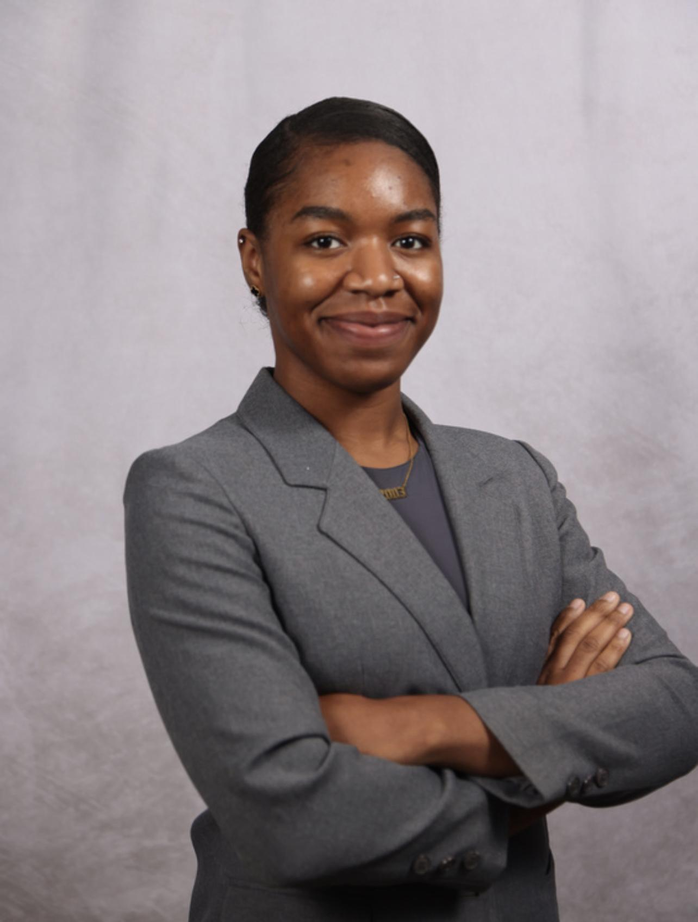

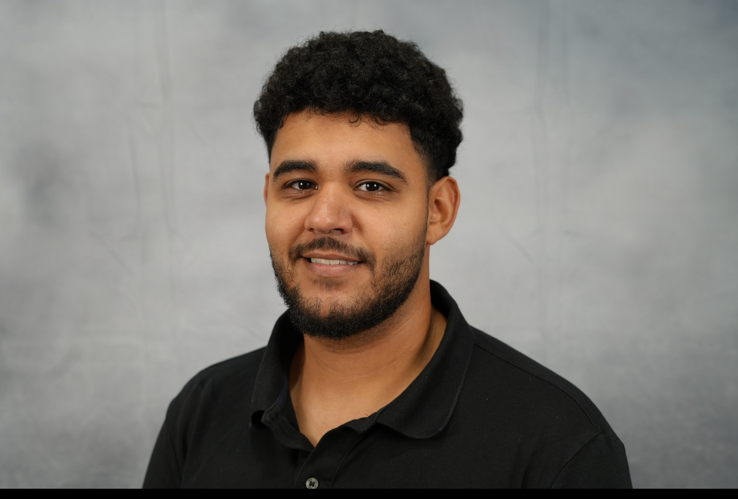
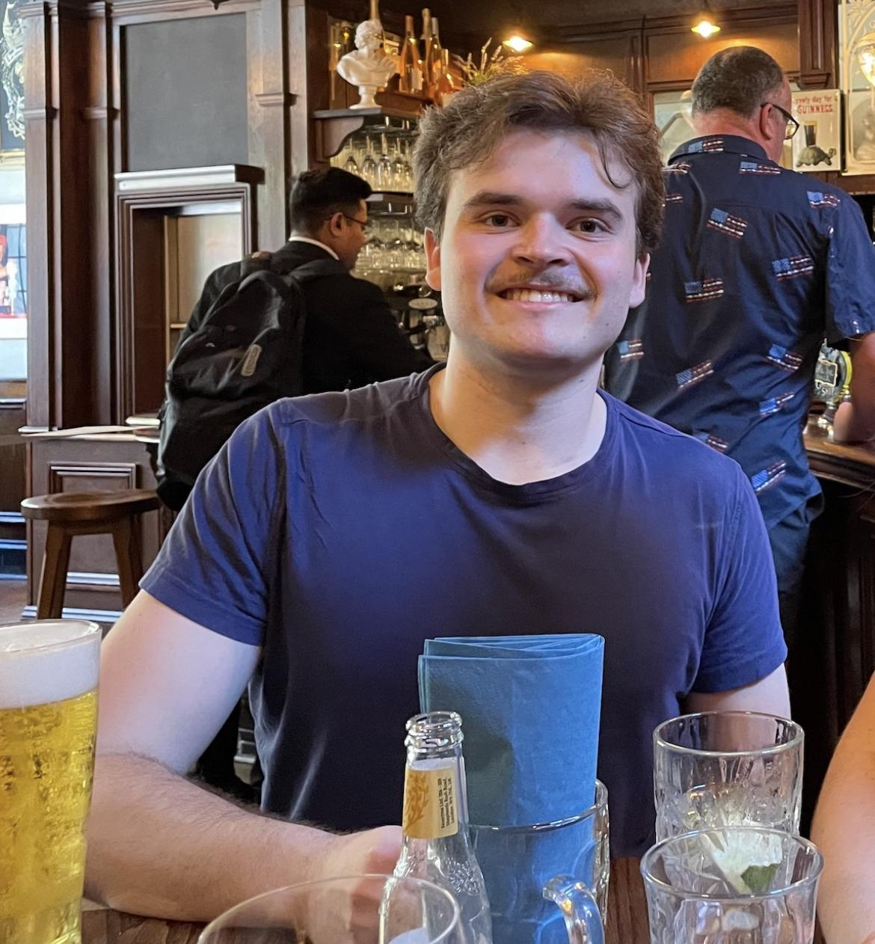
Members
Tommy Rose Project Manager
Deborah Alain Designer
Daniel Lee Client Communication Lead
Marco Asad Researcher

Slide 3
Challenges
Initial requirements and deliverables of the project
Efficient Communication
Time Management + Deadlines
New Town Seal drafting
Choosing integrated payment method for Jotform

Slide 4


Main Projects
(OLD)
Jotform
Initial audit of Jotform
Sync scanned PDF to Jotform fillables
Setup notification of new applications and status updates to submitter
Integrated Payment Option
Town Seal
Represents the town’s history of the first African American settlement
Requested colors: black, red, green, yellow
Stays true to nature of small town

Slide 5
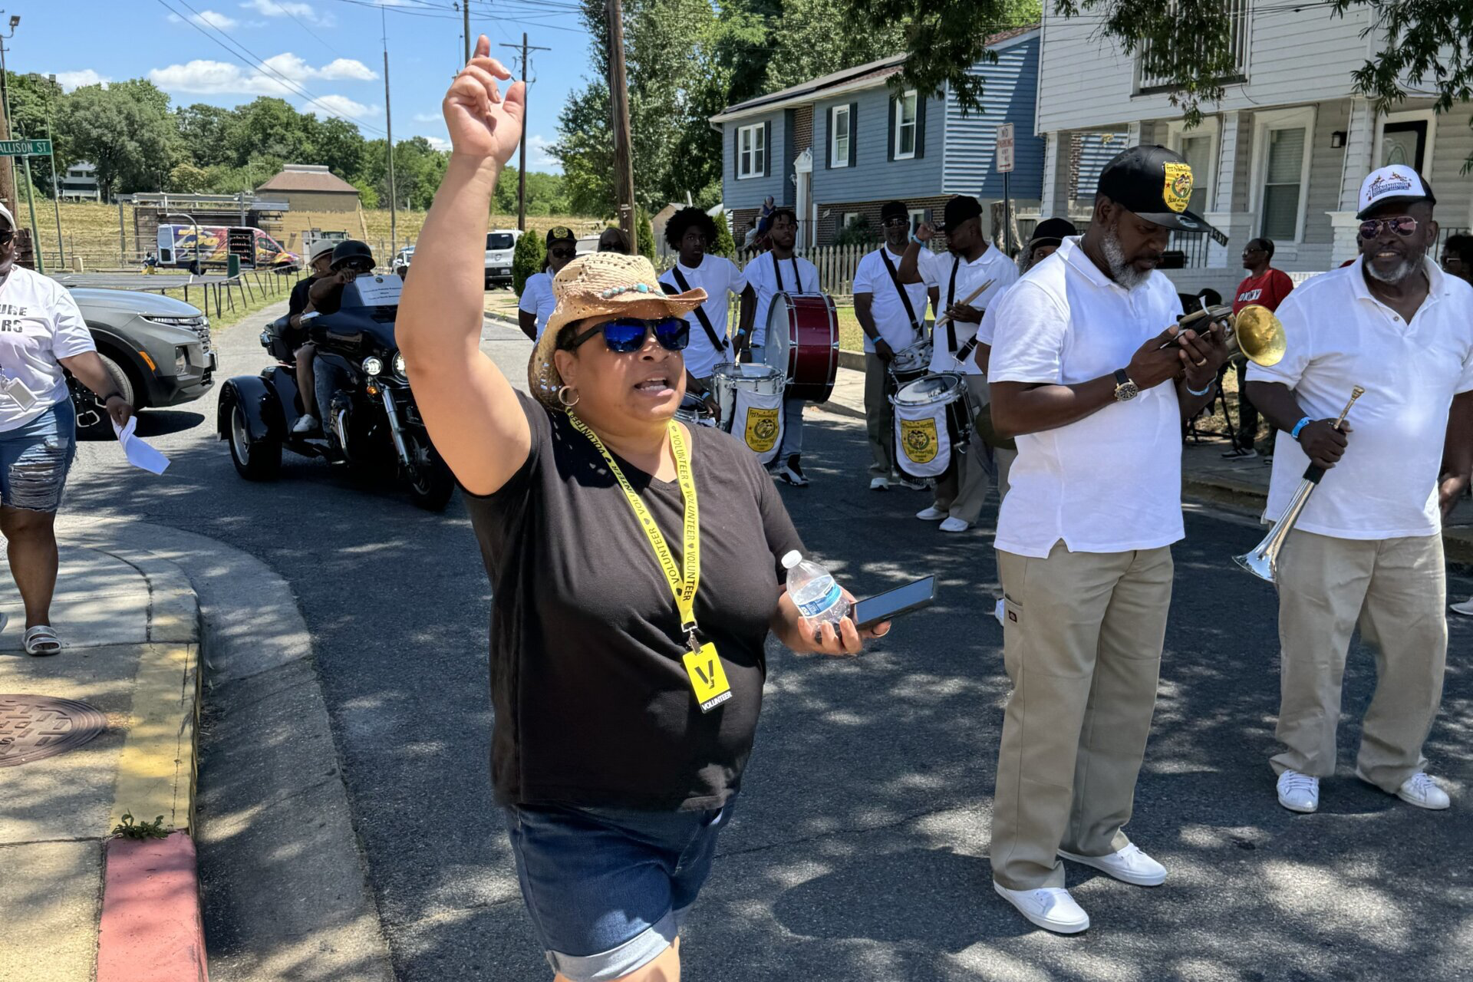
Client
Town of North Brentwood
Prince George's County's First African-American Settlement
Notes:
Deborah

Slide 6
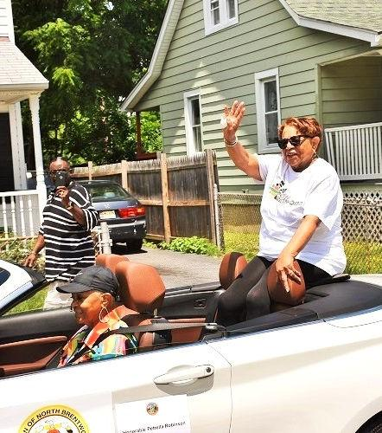
Background
Population of around 600
Located 2 miles from campus
Name originates from Brentwood D.C.
Founded: June 12, 1924
Values
Green, sustainable community
Diversity
Historical and cultural significance
Notes:
Deborah

Slide 7
Jotform

Slide 8
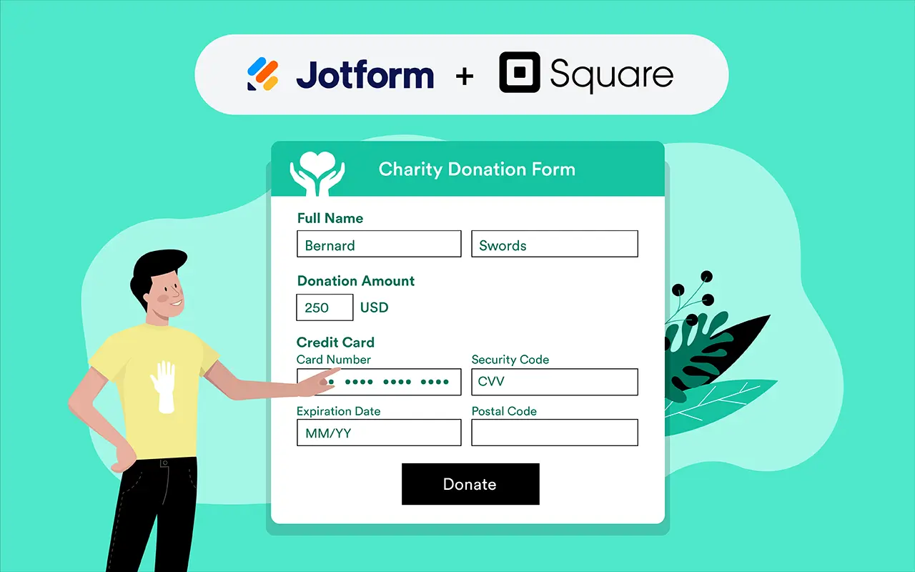
Jotform Features
Easy form building
Customizability
Payment Integration
Status Tracking
Fits North Brentwood’s use case

Slide 9
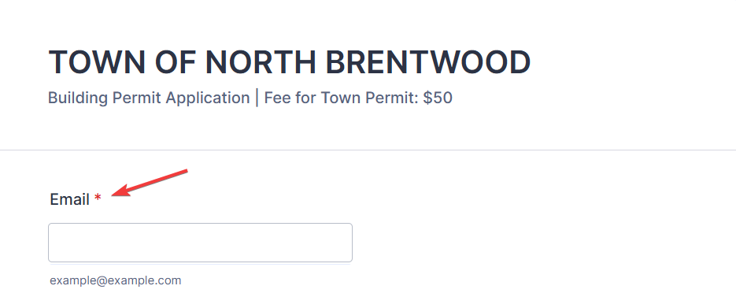
Jotform Initial Issues
Issue 1 Forms were asking for incorrect information
Issue 2 Necessary fields were not required
Issue 3 Different questions and answer options from scanned original documents

Slide 10
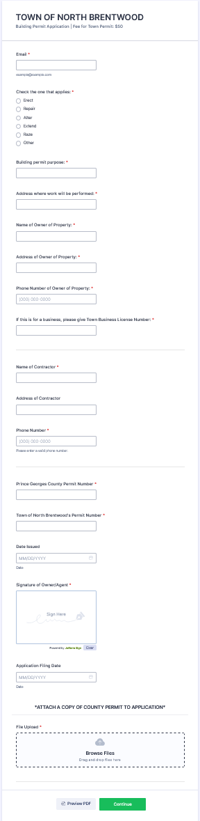
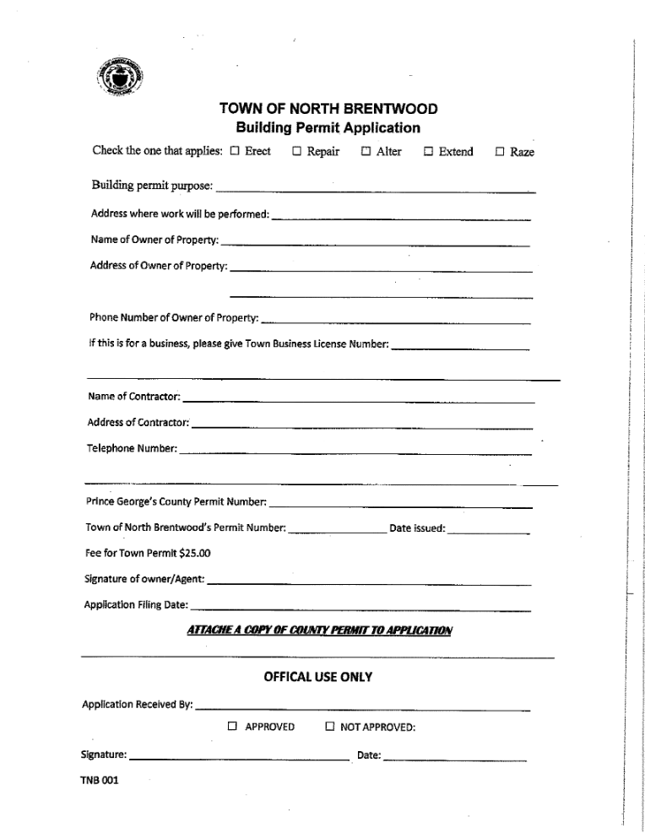
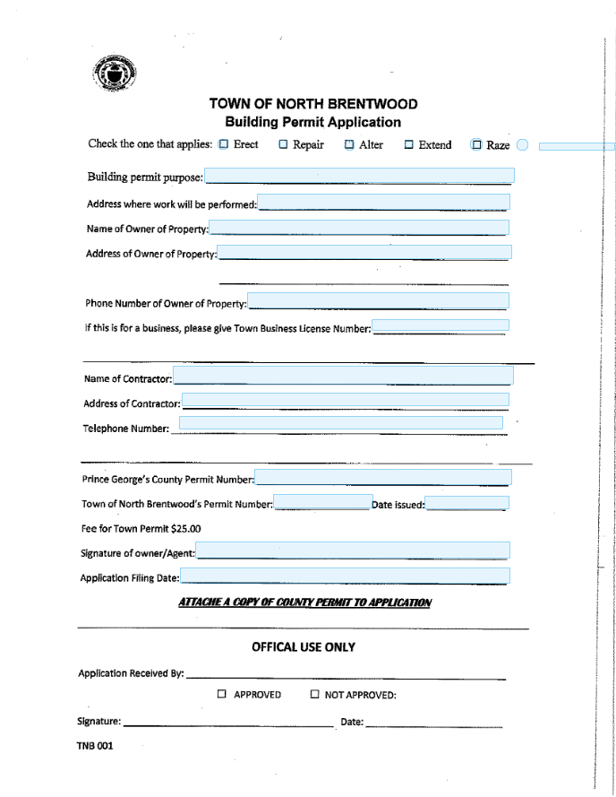
Process

Slide 11
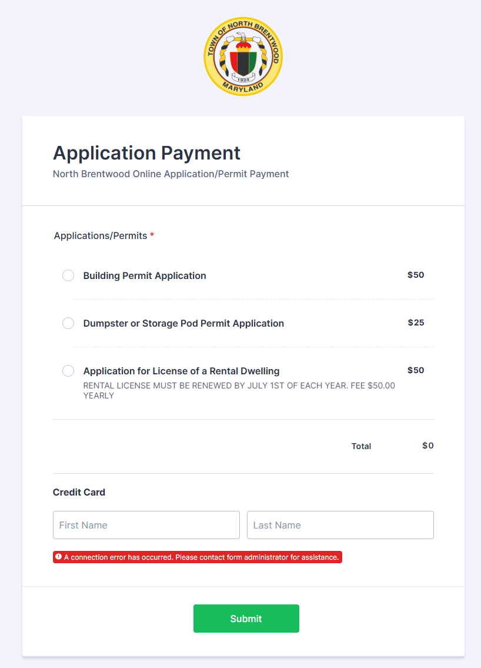
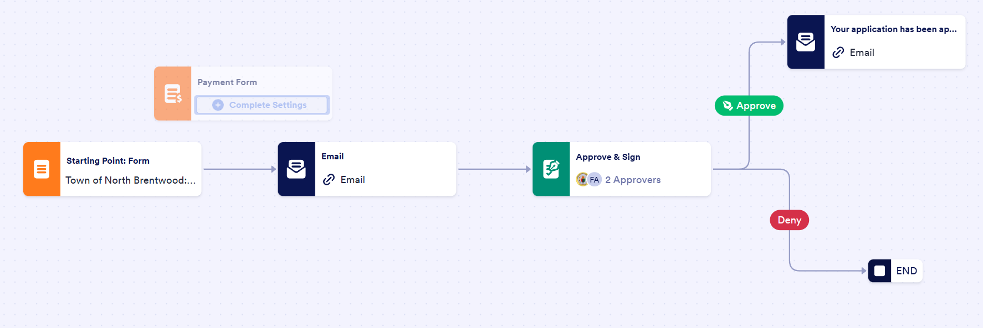
Payment Platform
Client chose Square
Unable to implement
Time constraints

Slide 12
Town Seals

Slide 13

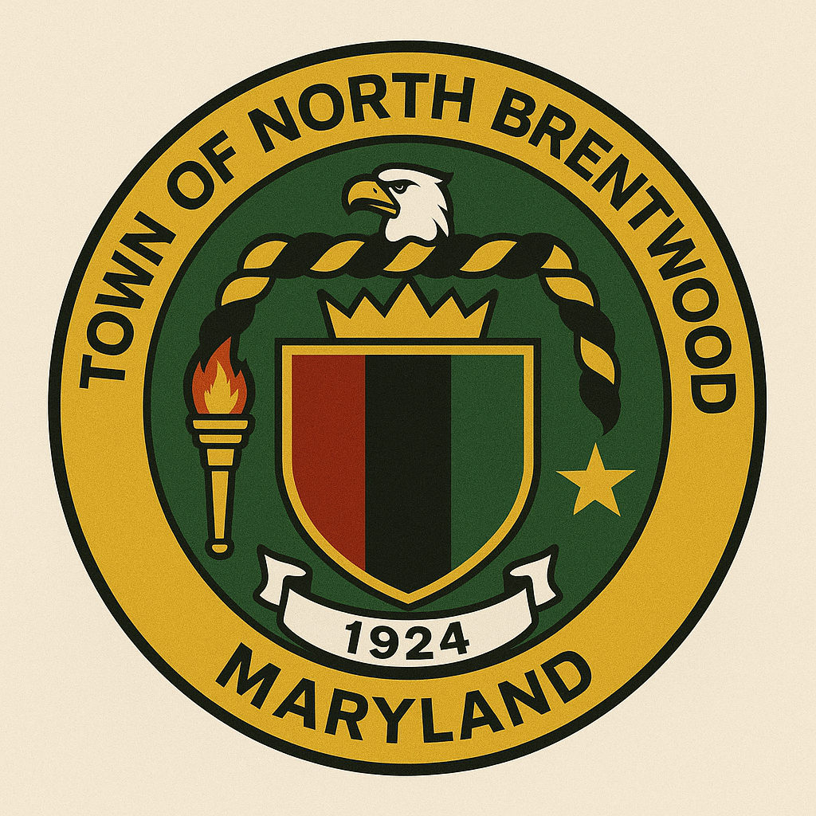
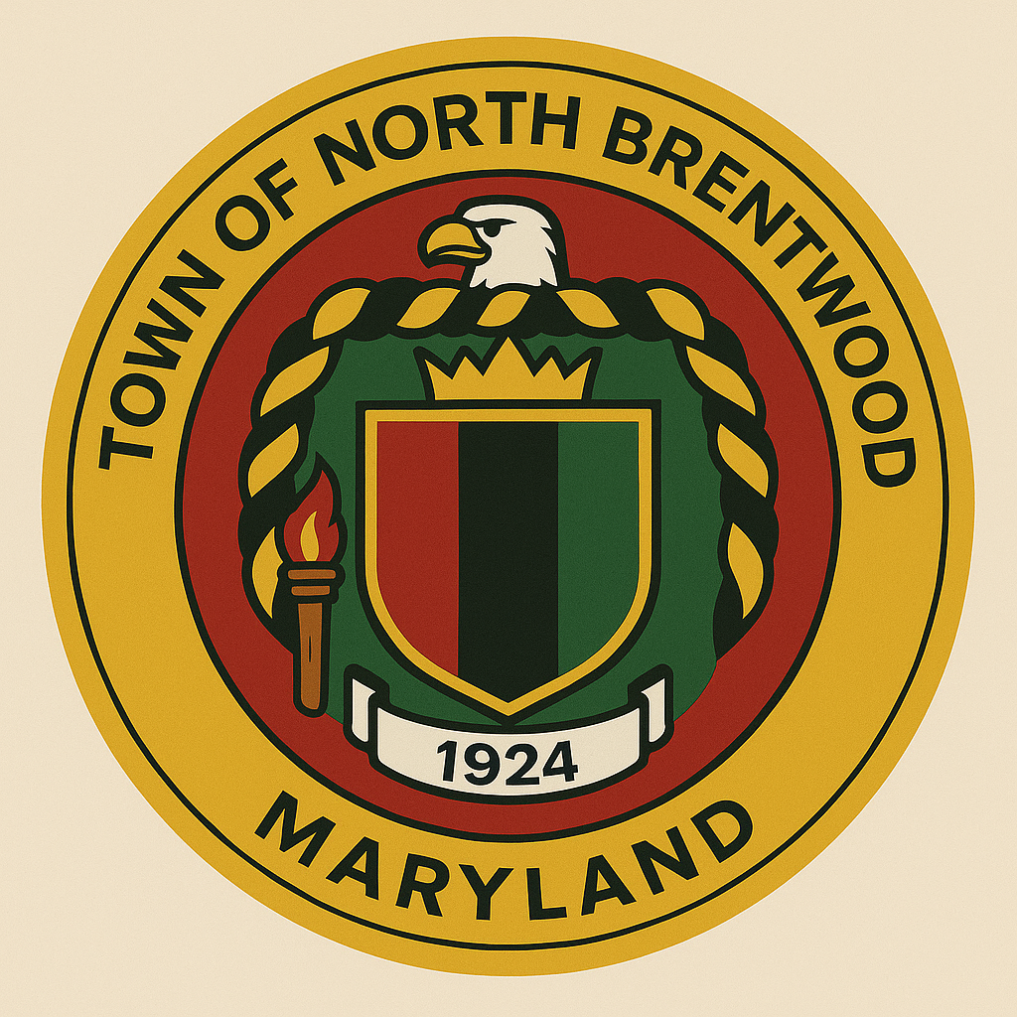
Town Seal 1st Prototypes
Original Town Seal
Updated Seal Designs

Slide 14


Town Seal 2nd Prototypes

Slide 15


Town Seal 3rd Prototypes

Slide 16
Next Steps
Recommendations
For next phase focus on Payment Integration
Another phase dedicated to Town Seal focusing on the history of North Brentwood
Handing off Project

Slide 17
Thank You!
North Brentwood Digitalization

